Slide 1
Google Dorks
Made by : Yukti Agarwal
Roll no.: 19csu366

Slide 2
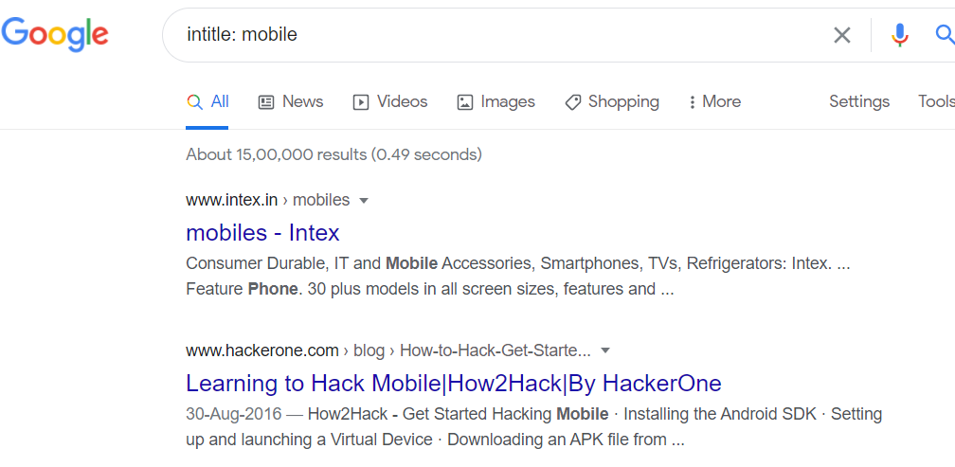
Intitle
It will give result in which keyword is in title of web page

Slide 3
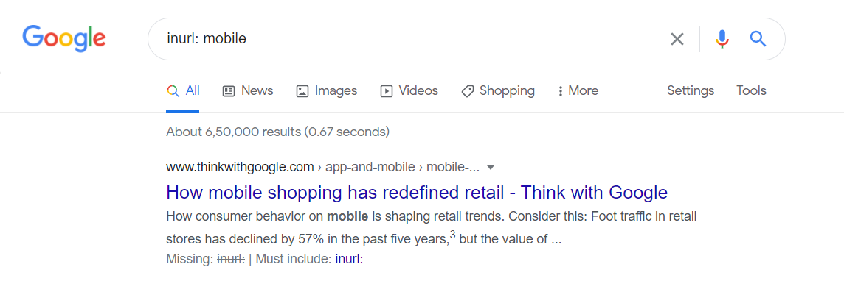
Inurl
It will give result in which keyword is in url

Slide 4
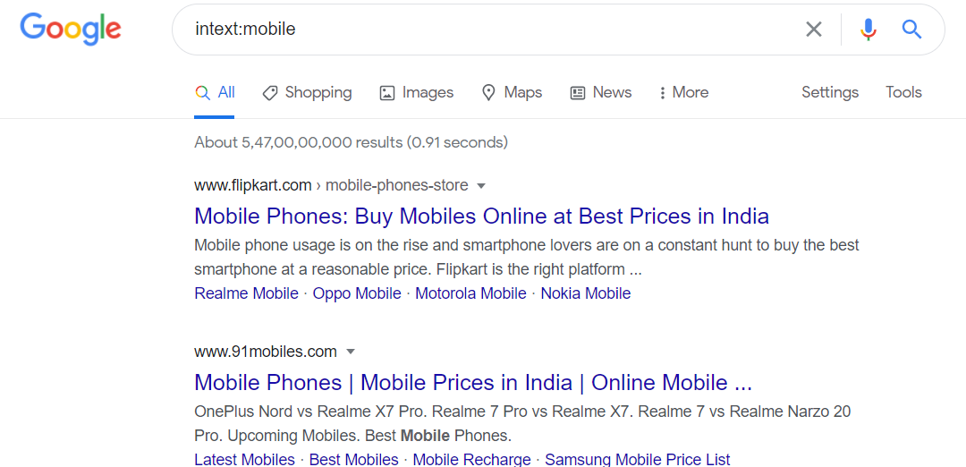
Intext
It will give result in which keyword is inside the text of web page

Slide 5
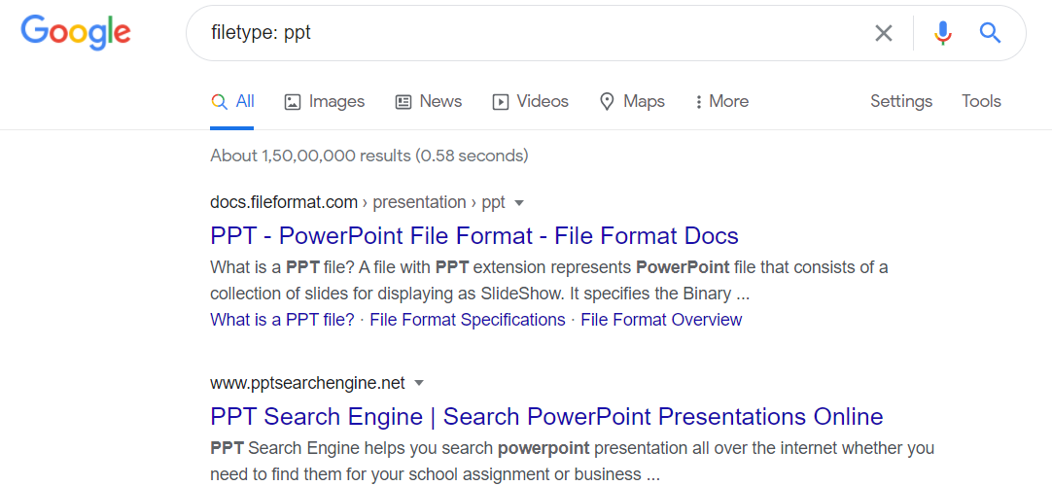
Filetype
Gives result which include files with searched type

Slide 6
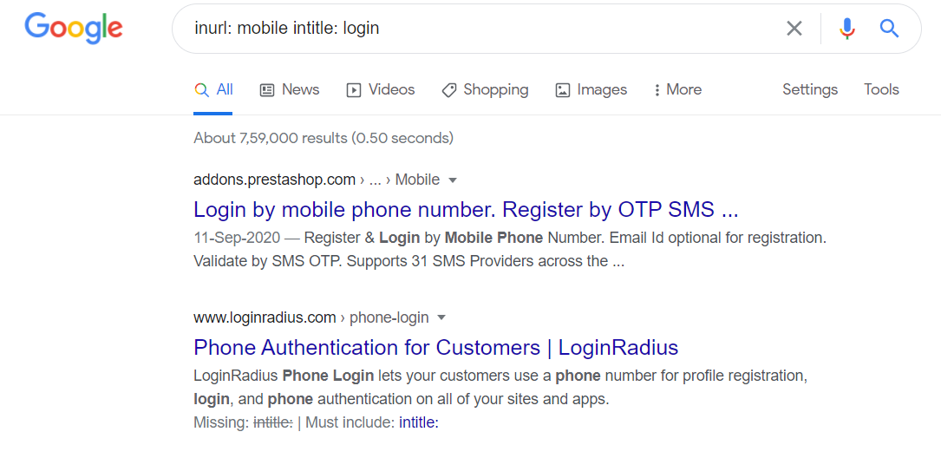
To get more specified search
Use of different search options together to be more specify with search

Slide 7
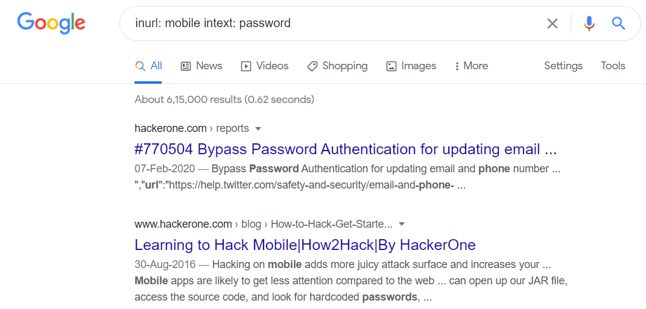

Slide 8
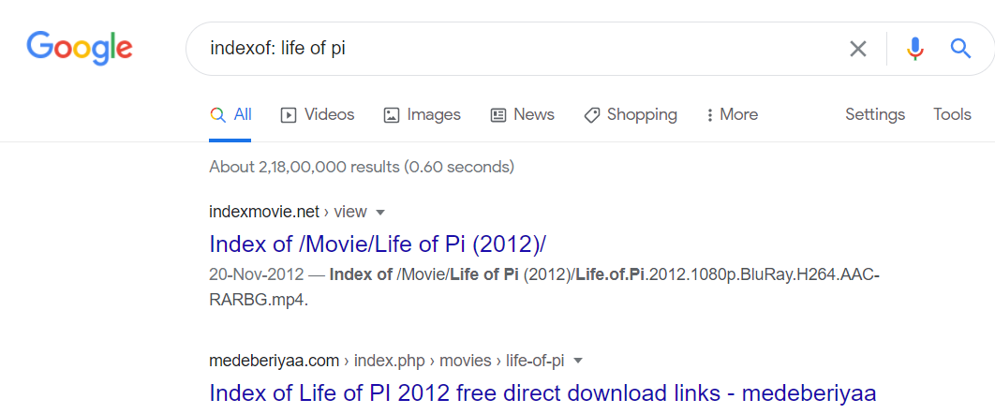
Indext of
Gives result which include keyword in the directories

Slide 9
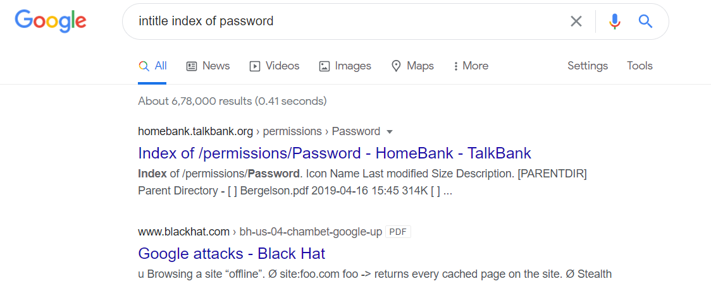
To get more specified search with indexof

Slide 10
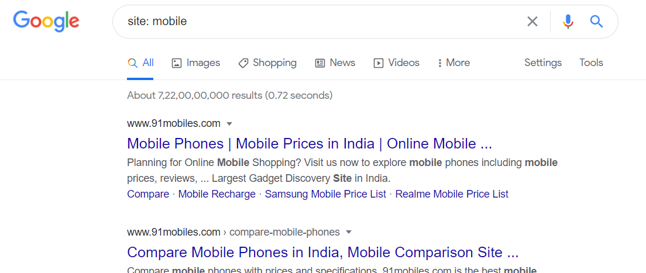
site
Gives result which include site with searched keyword

Slide 11
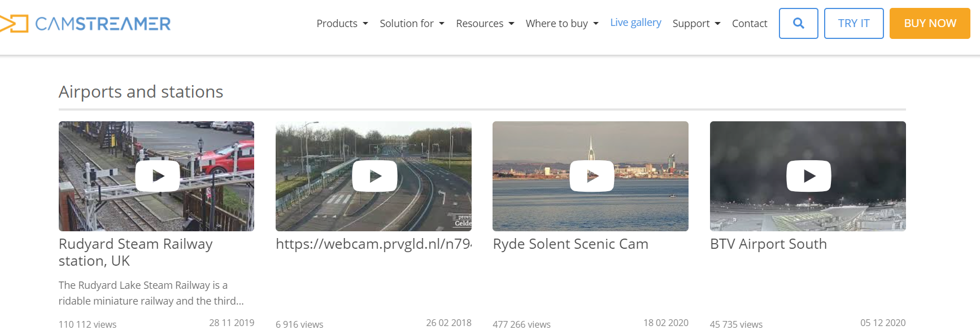
Information gathering camera’s
With the help of some google dorks like inurl:Live View / - AXIS and more we can get hold of what is happening around the world

